Slide 1
Choosing a location for a distribution center for a food supplier to maximize business.
Melvin Sebastian
Coursera Capstone

Slide 2
Introduction
In this project I aim to find location co-ordinates for a distribution center for a food supplier to maximize business.
We choose the city of New York to set up a distribution centre for a food supplier which is expanding.
The limitation of each distribution center is that we have a maximum radius for distribution of 4km. So our goal is to choose a location which would give maximum outreach.

Slide 3
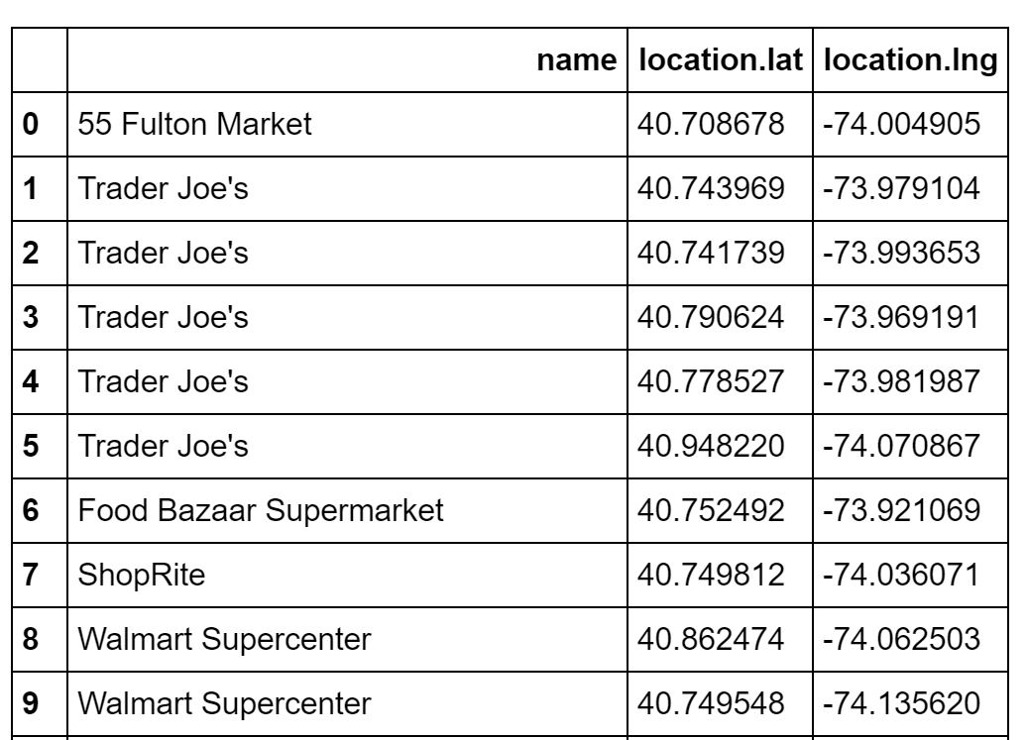
Data acquisition and cleaning:
For this project we use the map of New York. We use clustering to obtain clusters of supermarkets in New York based on their proximity to one another.
Hence to complete this project,we also need the coordinates of the various supermarkets in NY which can be easily obtained on Foursqaure using its API.
The data acquired from Foursquare is extremely unstructured. Hence we clean it and form a Pandas dataframe with three columns.

Slide 4
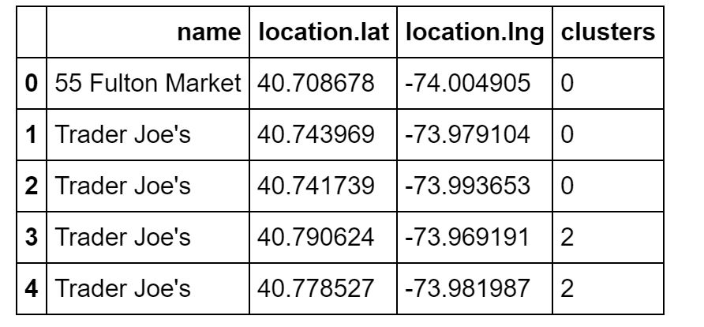
Machine Learning methodology:
Now that we have got all the data required, cleaned and structured.
We need to locate the actual point of the distribution centre to be build. We do that using a clustering method called mean-shift algorithm and we obtain the table with the clusters as follows:

Slide 5
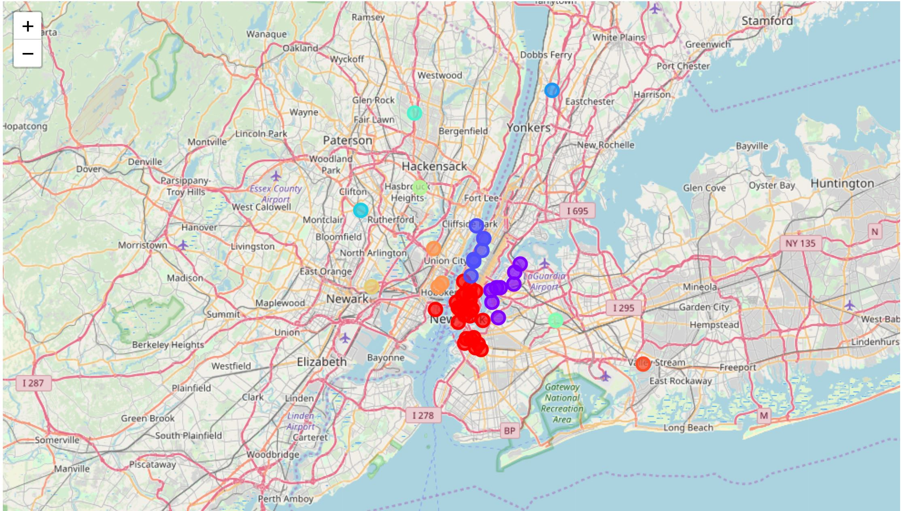
Results and discussion:
We have found the exact coordinates of our location required for the maximum outreach of supermarkets and this was found to be at 40.72438942 , -73.98987903.
The various supermarkets that comes under this distribution center is marked in red in the figure given.

Slide 6
Conclusion:
This project was executed successfully albeit a few drawbacks and improvementsthat can be done in the future.
These include including more data on the shops, eliminating the smaller supermarkets, including the scale of each supermarket,considering other factors such as locality, resources such as logistical services nearby etc., the terrain etc.
A firm can be greatly helped using this model with the above modifications which is unfortunately outside the scope of this capstone.

